Slide 1
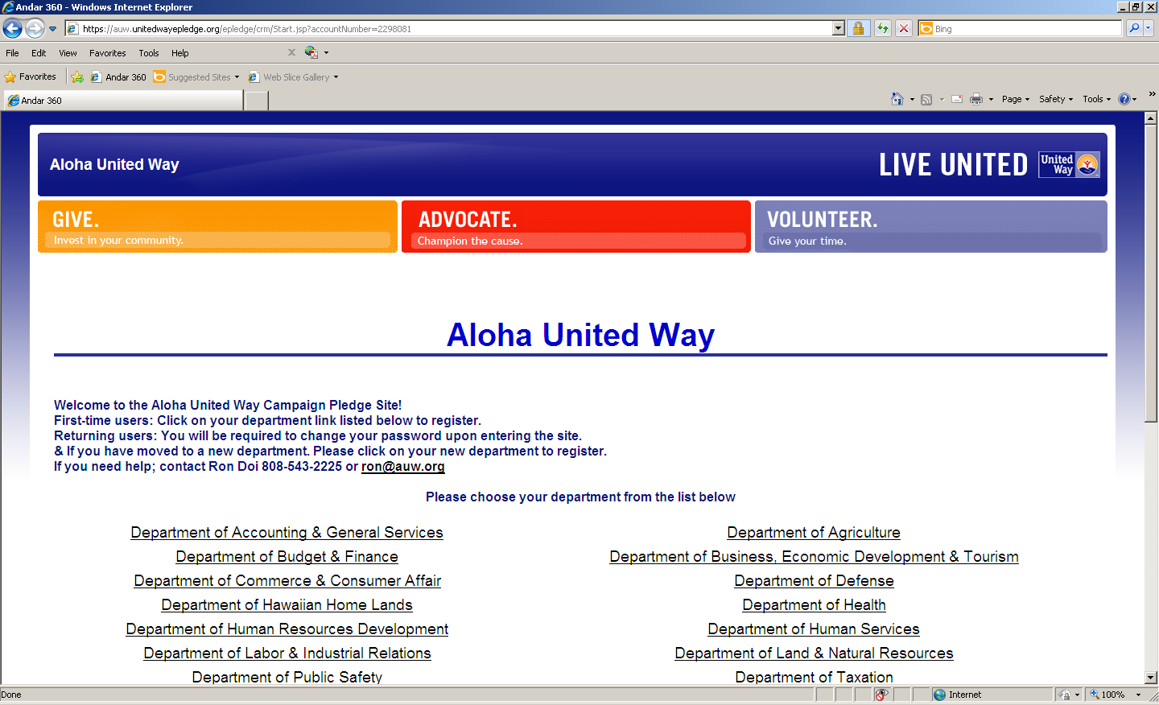

Slide 2
e-Pledge
Donor Registration
Input employee work email
Input code
Then click Register

Slide 3
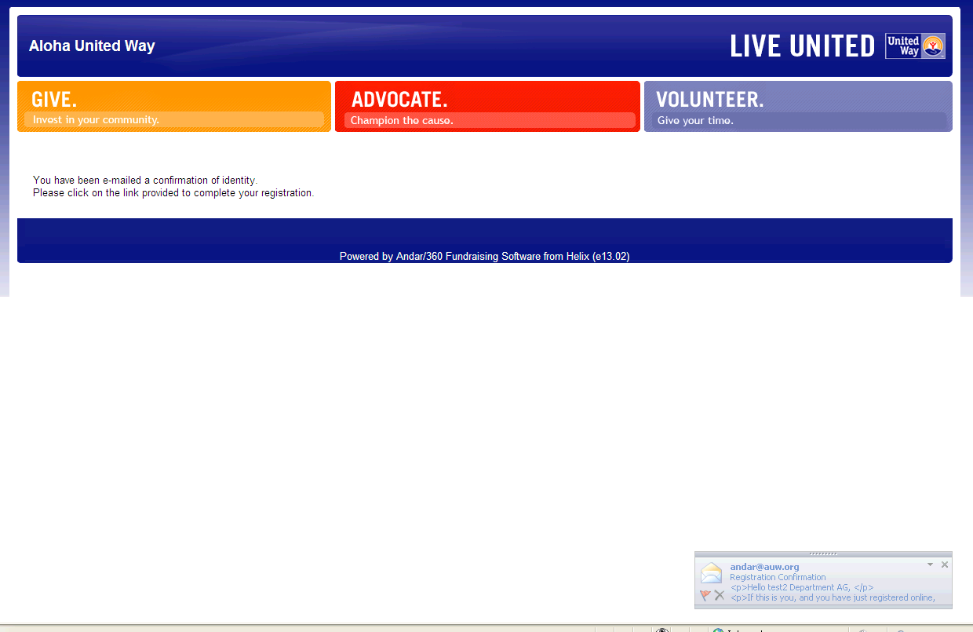
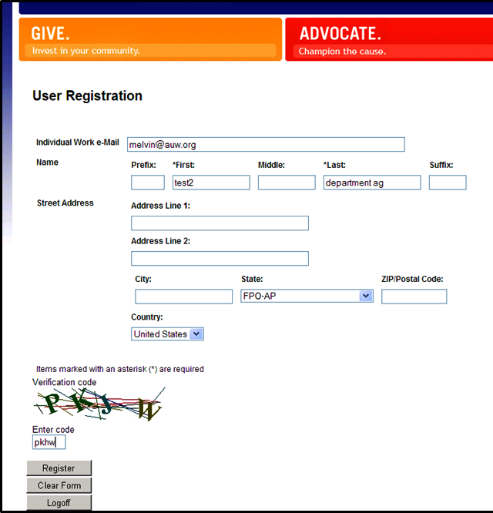
e-Pledge
Donor Registration
Finds Employee
Does Not Find Employee
Email message with instructions
Input Info
Name
Email
Registration confirmation to donor’s email
Enter Code and Register

Slide 4
e-Pledge
Your name will appear here
Click here to begin pledging process

Slide 5
e-Pledge
Pledge Types
Select how you would like to give.
Then click on “Next”.

Slide 6
e-Pledge
Enter Pledge Amount: Cash
Complete this section.
Click here to direct your gift.
Then click on “Next”.

Slide 7
e-Pledge
Enter Pledge Amount: Check
Complete this section.
Click here to direct your gift.
Then click on “Next”.

Slide 8
e-Pledge
Enter Pledge Amount: Credit Card
Please note.
Complete this section.
Click here to direct your gift.
Then click on “Next”.

Slide 9
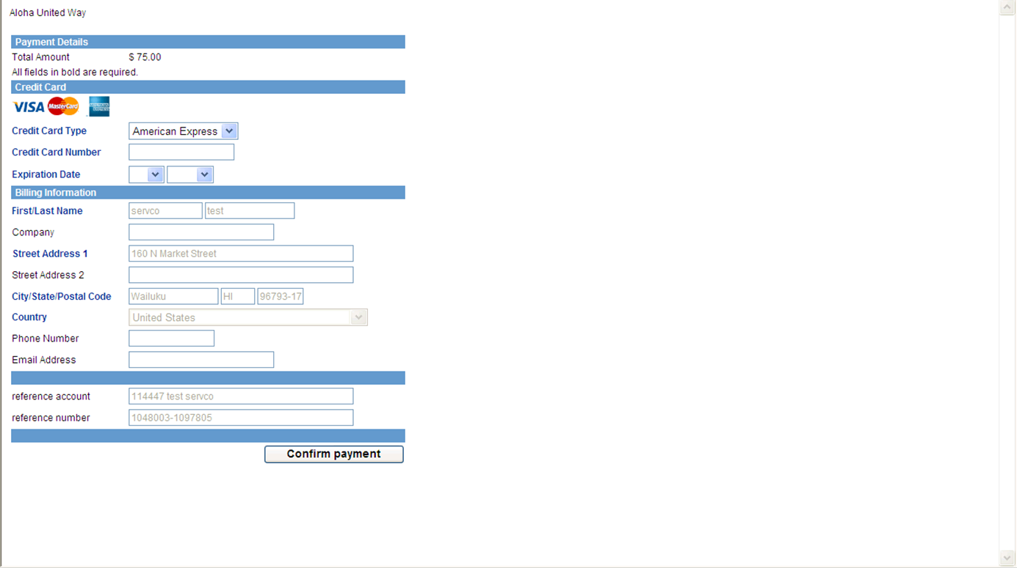
e-Pledge
Enter Pledge Amount: Credit Card
Complete this section as required by the credit card companies.
Then click on “Confirm Payment”.

Slide 10
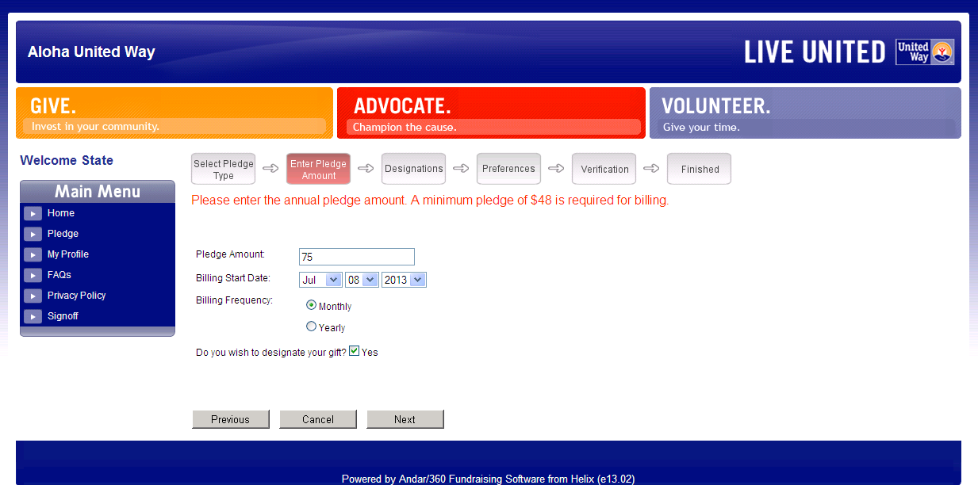
e-Pledge
Enter Pledge Amount: Bill Me
Complete this section
Click here to direct your gift.
Then click on “Next”

Slide 11
e-Pledge
Enter Pledge Amount: Payroll
Complete this section.
Click here to direct you gift.
Then click on “Next”.

Slide 12
e-Pledge
Enter Pledge Amount: Payroll
Complete this section.
Click here to direct you gift.
Then click on “Next”.

Slide 13
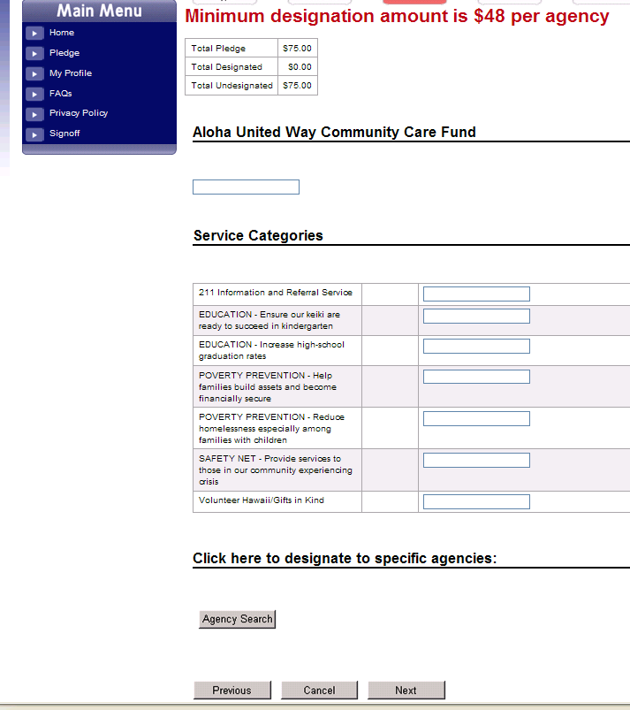
e-Pledge
Designations: AUW Community Care Fund
Click here to search for the agency of your choice.

Slide 14
e-Pledge
Designations: Agency Search
Complete this section.
Click here to search for the agency of your choice.

Slide 15
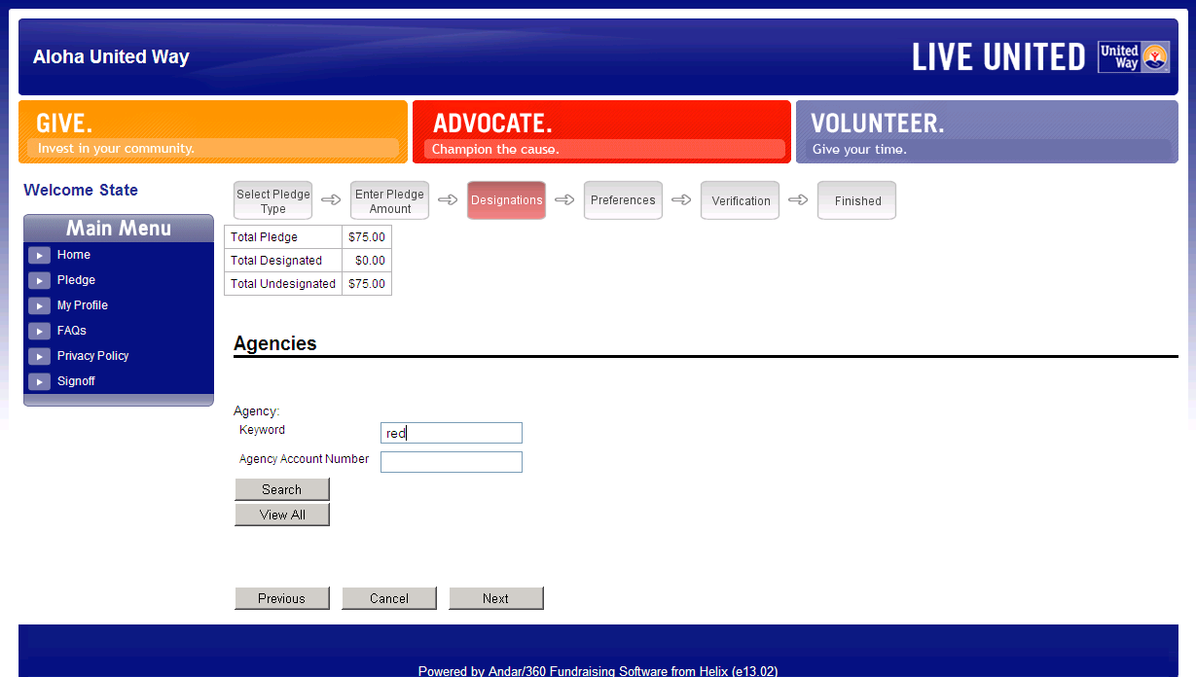
e-Pledge
Designations: Agency Search
Complete this section.
Click here to search for the agency of your choice.

Slide 16
e-Pledge
Designations: Select Agency
Enter agency amount
Indicates designated agency
and amount.

Slide 17
e-Pledge
Designations: Agency Selected
Indicates designated agency
and amount.

Slide 18
e-Pledge
Preferences
Click to “de-select” items.
Acknowledge – the above information will be used by AUW to acknowledge your pledge.
Release – information will be released to designated agency.

Slide 19
e-Pledge
Verification
Review all information.
If information is correct, click on “Confirm”.
If changes are needed, click on “Previous” to make changes.

Slide 20
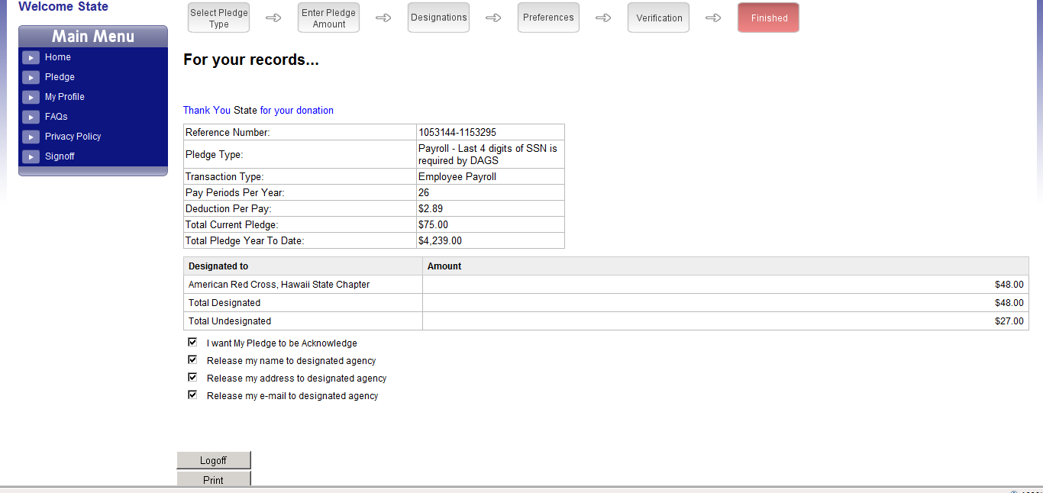
e-Pledge
For Your Records
Print for receipt purposes

